Slide 1
OBESITÀ, CHIRURGIA BARIATRICA E PROCREAZIONE MEDICALMENTE ASSISTITA
Amanda belluzzi,MD
U.O.C. chirurgia generale, Ospedale S. Maria della Misericordia, Rovigo

Slide 2

KEY POINTS
Obesità , fertilità e riproduzione
Impatto dell’obesità sulle procedure di Procreazione Medicalmente Assistita(PMA)
Impatto della Chirurgia Bariatrica e Metabolica sulle procedure di Procreazione Medicalmente Assistita (PMA)

Slide 3
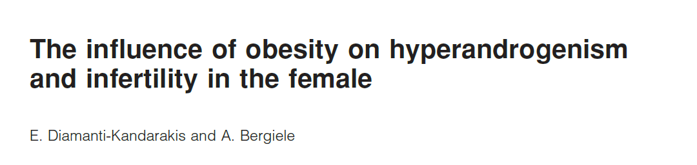
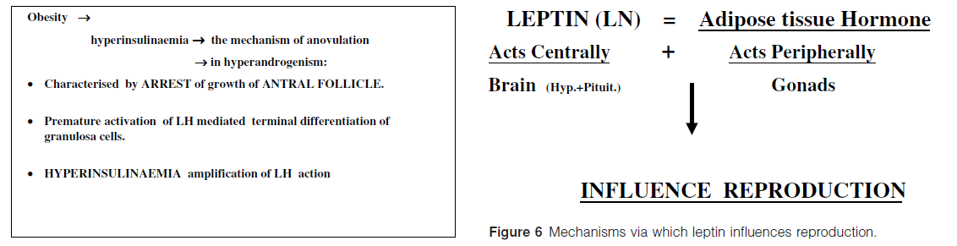
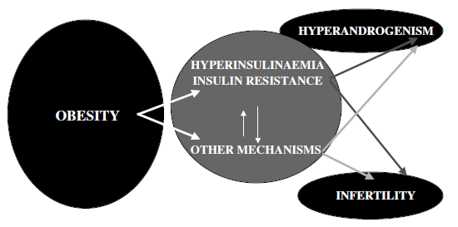
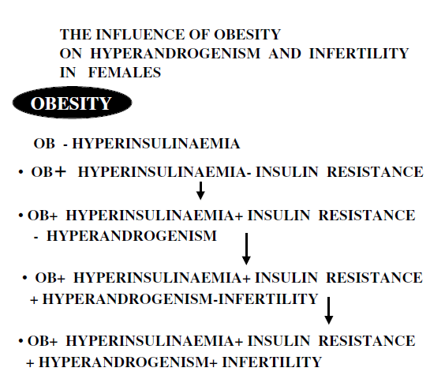
Obesità, Chirurgia Bariatrica e Procreazione Medicalmente Assistita
Obesità , fertilità e riproduzione
2001
Diamanti-Kandarakis E, Bergiele A. The influence of obesity on hyperandrogenism and infertility in the female. Obes Rev. 2001 Nov;2(4):231-8.

Slide 4
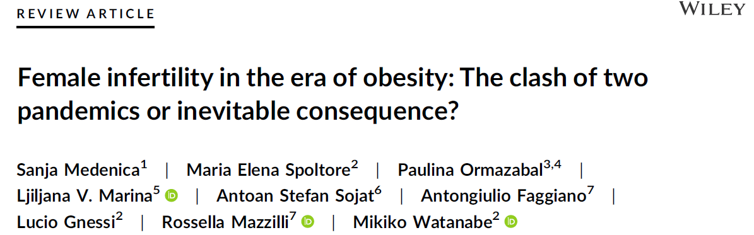
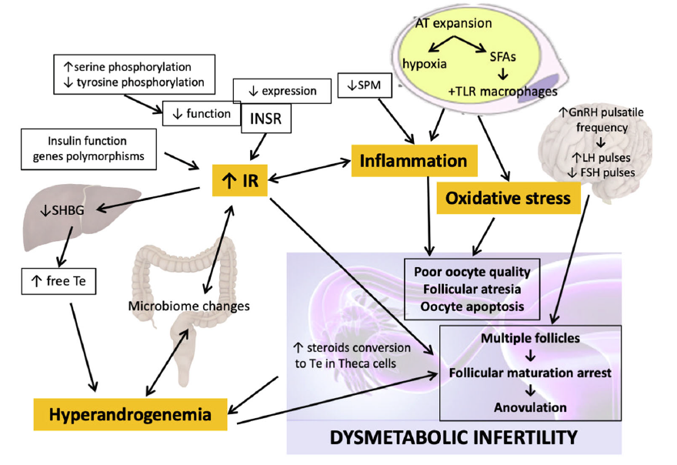
Obesità, Chirurgia Bariatrica e Procreazione Medicalmente Assistita
Obesità , fertilità e riproduzione
2023
Medenica S, Spoltore ME, Ormazabal P, Marina LV, Sojat AS, Faggiano A, Gnessi L, Mazzilli R, Watanabe M. Female infertility in the era of obesity: The clash of two pandemics or inevitable consequence? Clin Endocrinol (Oxf). 2023 Feb;98(2):141-152.

Slide 5
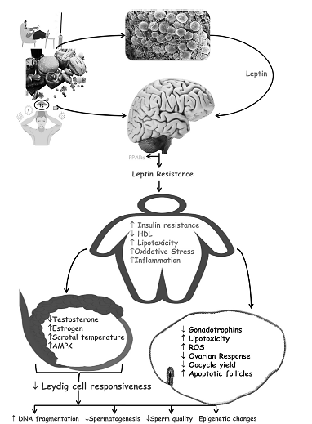
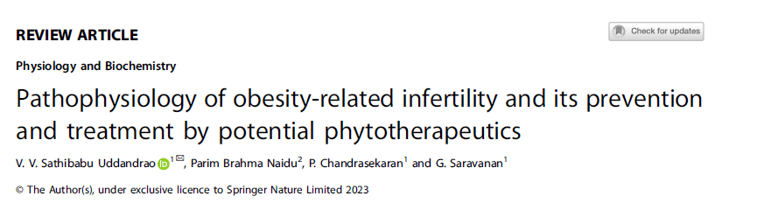
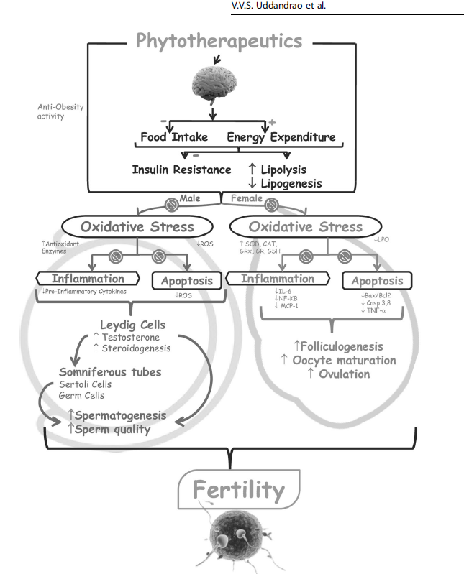
Obesità, Chirurgia Bariatrica e Procreazione Medicalmente Assistita
Obesità , fertilità e riproduzione
2024
Uddandrao VVS, Brahma Naidu P, Chandrasekaran P, Saravanan G. Pathophysiology of obesity-related infertility and its prevention and treatment by potential phytotherapeutics. Int J Obes (Lond). 2024 Feb;48(2):147-165.

Slide 6
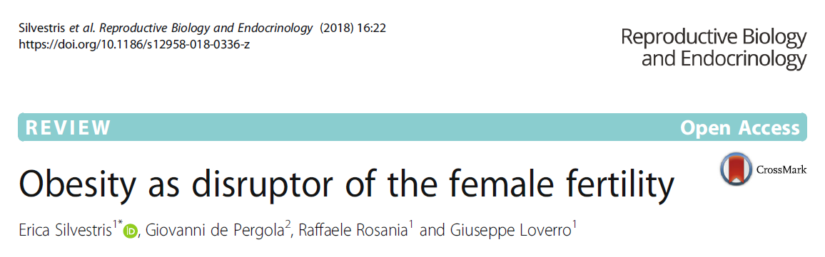
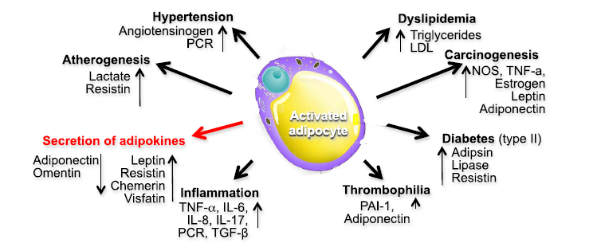
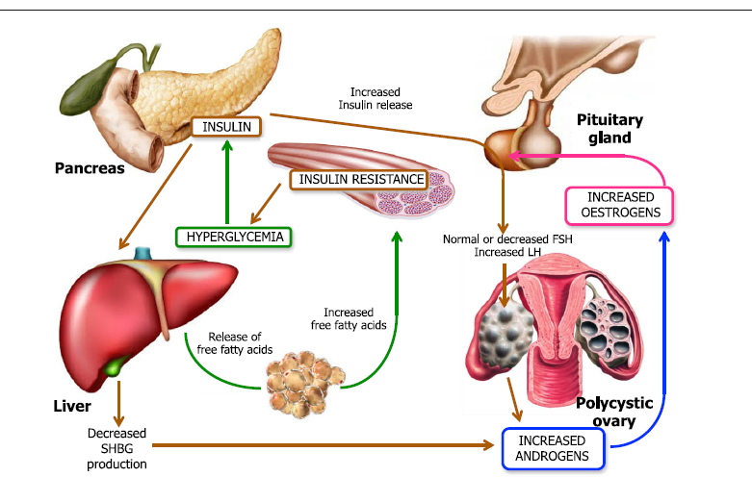
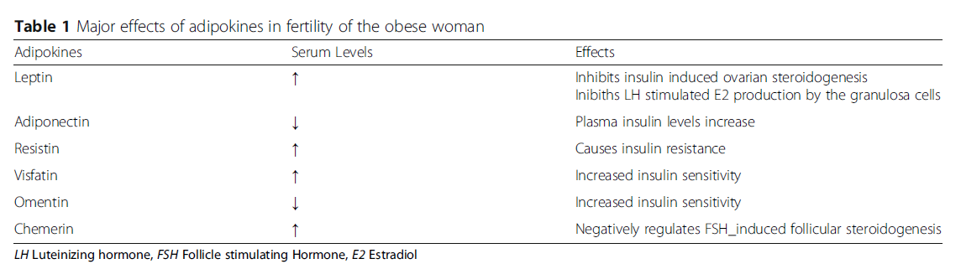
Obesità, Chirurgia Bariatrica e Procreazione Medicalmente Assistita
Obesità , fertilità e riproduzione
2018
Silvestris E, de Pergola G, Rosania R, Loverro G. Obesity as disruptor of the female fertility. Reprod Biol Endocrinol. 2018 Mar 9;16(1):22.

Slide 7
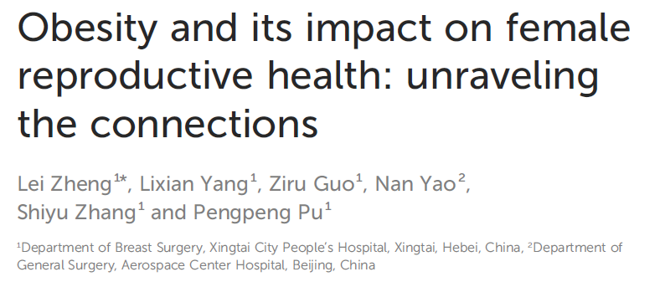
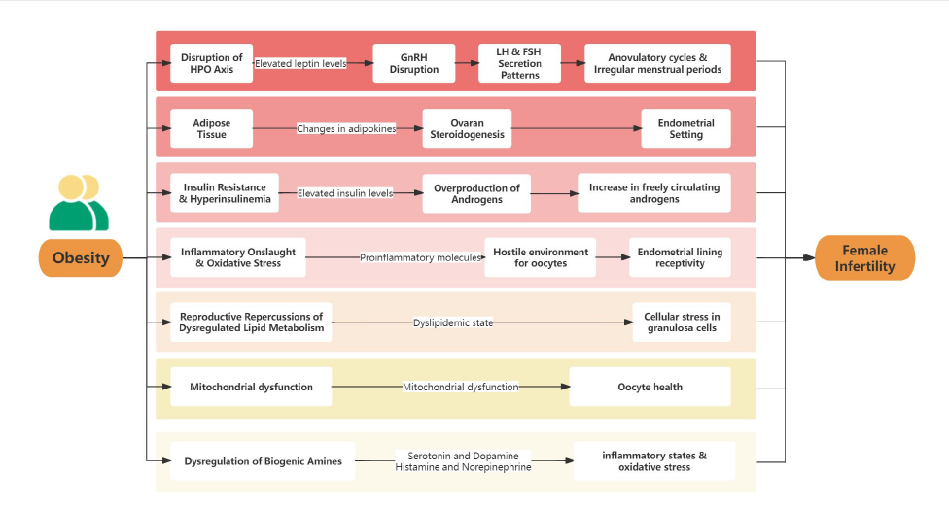
Obesità, Chirurgia Bariatrica e Procreazione Medicalmente Assistita
Obesità , fertilità e riproduzione
2024
Zheng L, Yang L, Guo Z, Yao N, Zhang S, Pu P. Obesity and its impact on female reproductive health: unraveling the connections. Front Endocrinol (Lausanne). 2024 Jan 9;14:1326546.

Slide 8
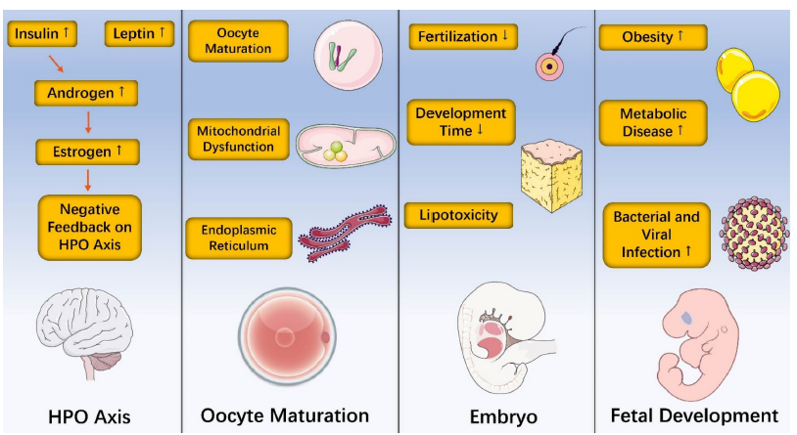
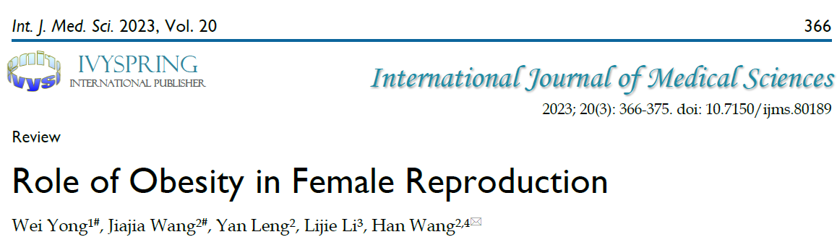
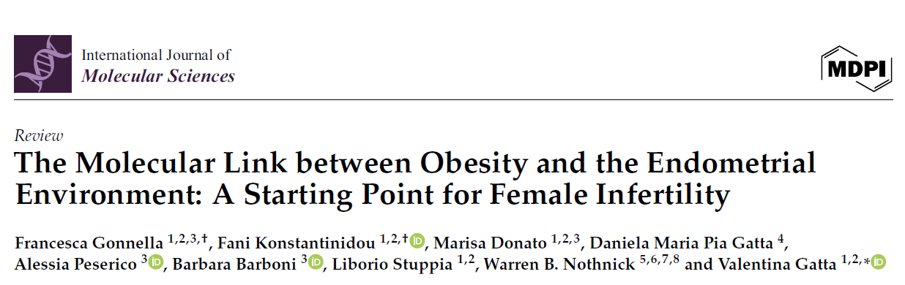
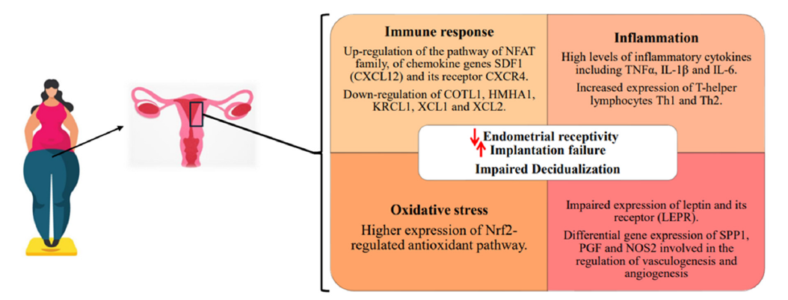
Obesità, Chirurgia Bariatrica e Procreazione Medicalmente Assistita
Obesità , fertilità e riproduzione
2023
2024
Yong W, Wang J, Leng Y, Li L, Wang H. Role of Obesity in Female Reproduction. Int J Med Sci. 2023 Jan 31;20(3):366-375.
Gonnella F, Konstantinidou F, Donato M, Gatta DMP, Peserico A, Barboni B, Stuppia L, Nothnick WB, Gatta V. The Molecular Link between Obesity and the Endometrial Environment: A Starting Point for Female Infertility. Int J Mol Sci. 2024 Jun 22;25(13):6855.

Slide 9
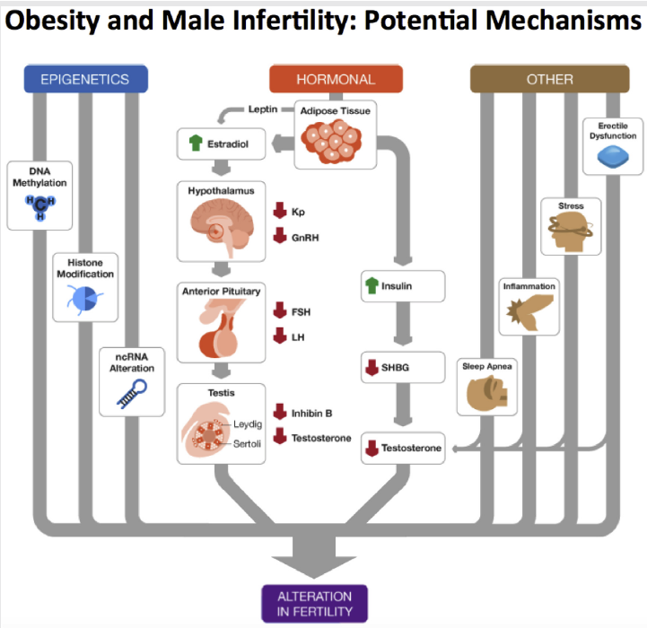
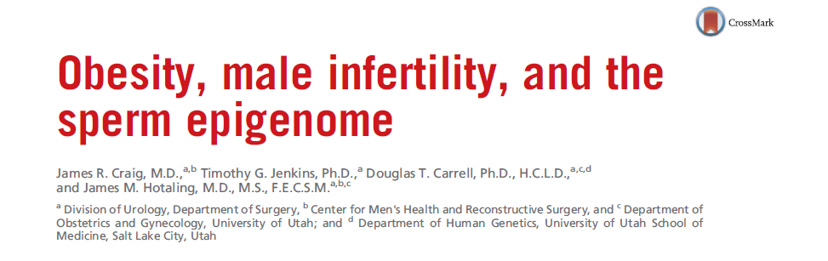
Obesità, Chirurgia Bariatrica e Procreazione Medicalmente Assistita
Obesità , fertilità e riproduzione
2018
Craig JR, Jenkins TG, Carrell DT, Hotaling JM. Obesity, male infertility, and the sperm epigenome. Fertil Steril. 2017 Apr;107(4):848-859.

Slide 10
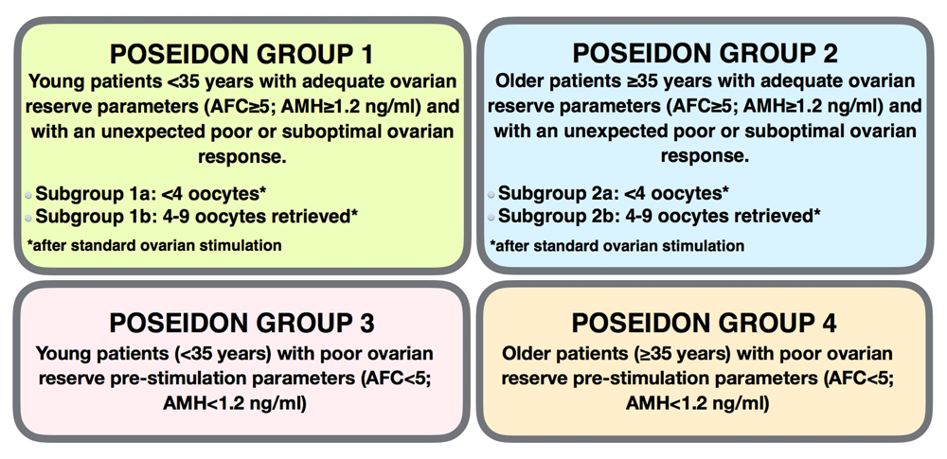
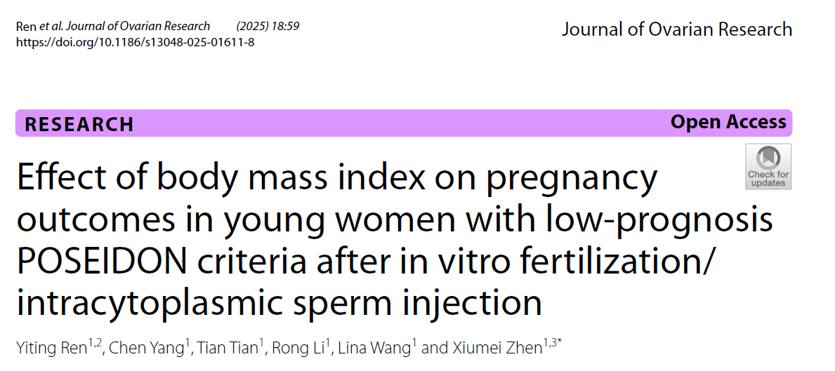
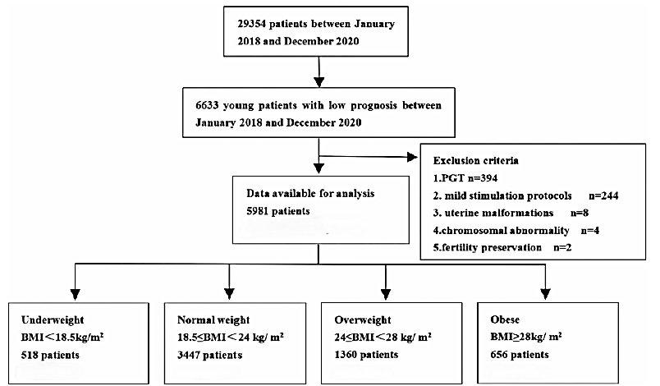
Obesità, Chirurgia Bariatrica e Procreazione Medicalmente Assistita
Impatto dell’obesità sulle procedure di Procreazione Medicalmente Assistita
2025
Ren Y, Yang C, Tian T, Li R, Wang L, Zhen X. Effect of body mass index on pregnancy outcomes in young women with low-prognosis POSEIDON criteria after in vitro fertilization/intracytoplasmic sperm injection. J Ovarian Res. 2025 Mar 22;18(1):59.
Ferraretti AP, La Marca A, Fauser BC, Tarlatzis B, Nargund G, Gianaroli L; ESHRE working group on Poor Ovarian Response Definition. ESHRE consensus on the definition of 'poor response' to ovarian stimulation for in vitro fertilization: the Bologna criteria. Hum Reprod. 2011 Jul;26(7):1616-24.

Slide 11
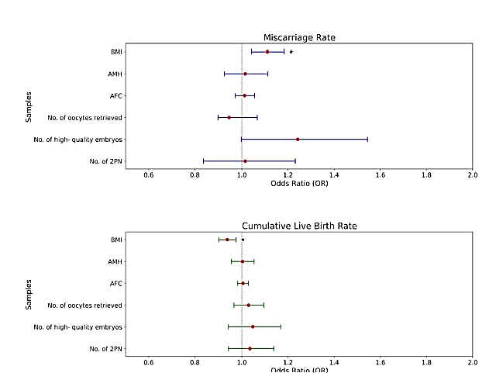
Obesità, Chirurgia Bariatrica e Procreazione Medicalmente Assistita
Impatto dell’obesità sulle procedure di Procreazione Medicalmente Assistita
2025
No significant differences in the implantation rate and clinical pregnancy rate, regardless of fresh embryo transfer or frozen embryo transfer among the four groups (P > 0.05).
The miscarriage rate of fresh embryo transfer was significantly higher in obese patients (P < 0.05), while the live birth rate of fresh embryo transfer and the cumulative live birth rate are significantly lower in obese patients (P < 0.05).
BMI was a significant and independent predictor of the miscarriage rate of fresh embryo transfer (adjusted OR 1.111; 95% CI 1.042–1.184; p = 0.001) and the cumulative live-birth rate (adjusted OR 0.937; 95% CI 0.900–0.975; p = 0.001).
Ren Y, Yang C, Tian T, Li R, Wang L, Zhen X. Effect of body mass index on pregnancy outcomes in young women with low-prognosis POSEIDON criteria after in vitro fertilization/intracytoplasmic sperm injection. J Ovarian Res. 2025 Mar 22;18(1):59.

Slide 12
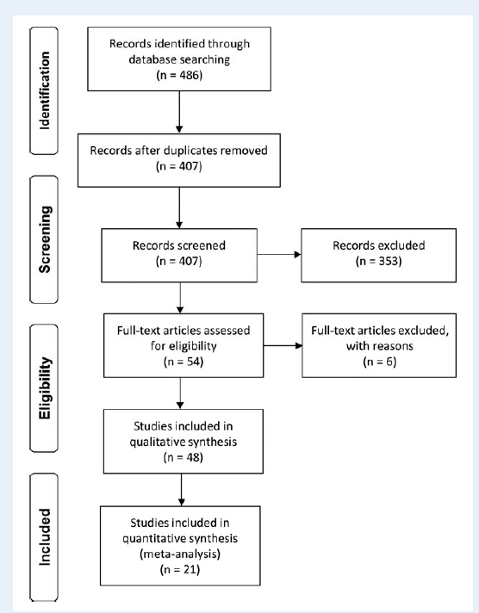
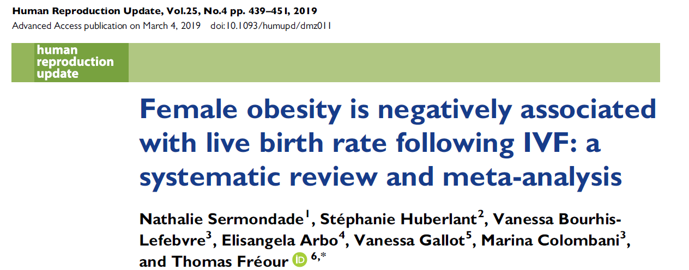
Obesità, Chirurgia Bariatrica e Procreazione Medicalmente Assistita
Impatto dell’obesità sulle procedure di Procreazione Medicalmente Assistita
2019
Total of 21 studies were included.
A decreased probability of live birth following IVF was observed in obese (BMI ≥ 30 kg/m²) women when compared with normal weight (BMI 18.5–24.9 kg/m²) women: risk ratio (RR) (95% CI) 0.85 (0.82–0.87).
Subgroups analyses demonstrated that prognosis was poorer when obesity was associated with polycystic ovary syndrome, while the oocyte origin (donor or non-donor) did not modify the overall interpretation.
This meta-analysis based on 682 532 cycles demonstrates that female obesity has a significant deleterious effect on LBR following IVF. Obese women had a significantly decreased chance of giving birth following IVF when compared with normal weight women (RR, IC95%: 0.85, 0.84–0.87). LBR was also significantly lower in overweight women (RR, IC95%: 0.94, 0.91–0.97).
Sermondade N, Huberlant S, Bourhis-Lefebvre V, Arbo E, Gallot V, Colombani M, Fréour T. Female obesity is negatively associated with live birth rate following IVF: a systematic review and meta-analysis. Hum Reprod Update. 2019 Jul 1;25(4):439-451.

Slide 13
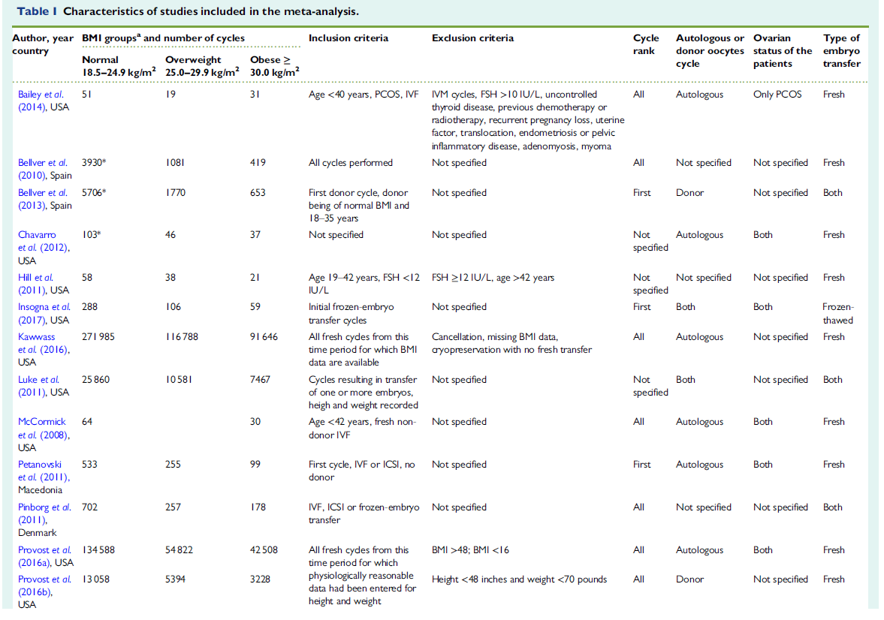
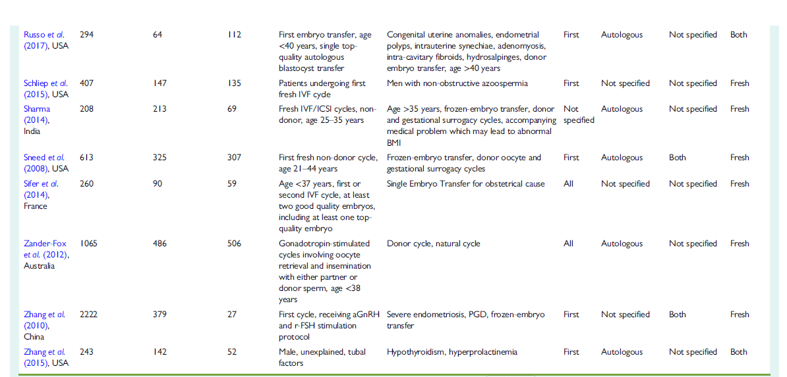
Obesità, Chirurgia Bariatrica e Procreazione Medicalmente Assistita
Impatto dell’obesità sulle procedure di Procreazione Medicalmente Assistita
2019
Sermondade N, Huberlant S, Bourhis-Lefebvre V, Arbo E, Gallot V, Colombani M, Fréour T. Female obesity is negatively associated with live birth rate following IVF: a systematic review and meta-analysis. Hum Reprod Update. 2019 Jul 1;25(4):439-451.

Slide 14
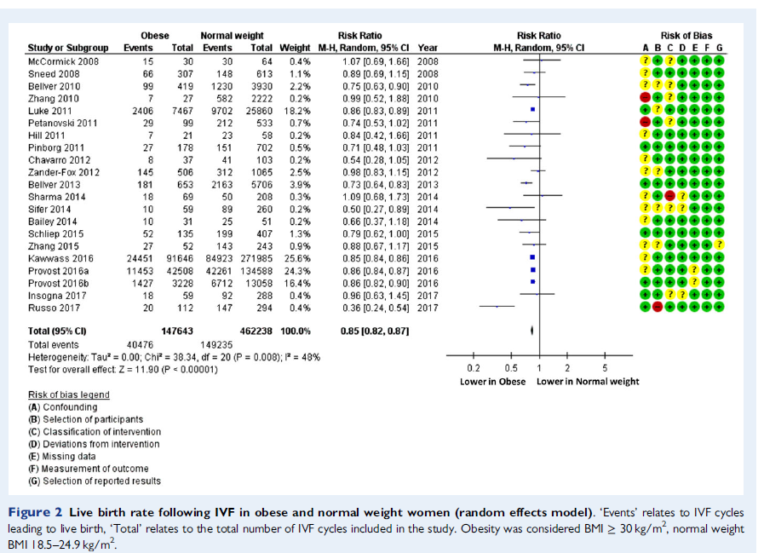
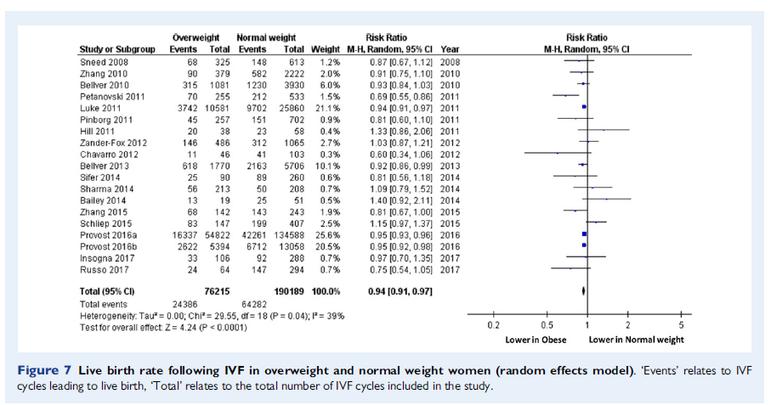
Obesità, Chirurgia Bariatrica e Procreazione Medicalmente Assistita
Impatto dell’obesità sulle procedure di Procreazione Medicalmente Assistita
2019
Sermondade N, Huberlant S, Bourhis-Lefebvre V, Arbo E, Gallot V, Colombani M, Fréour T. Female obesity is negatively associated with live birth rate following IVF: a systematic review and meta-analysis. Hum Reprod Update. 2019 Jul 1;25(4):439-451.

Slide 15
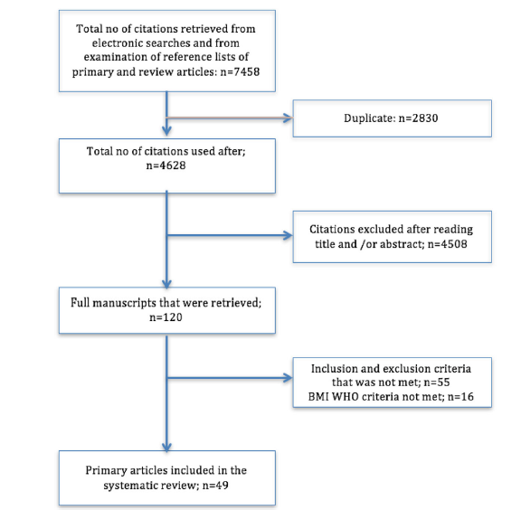
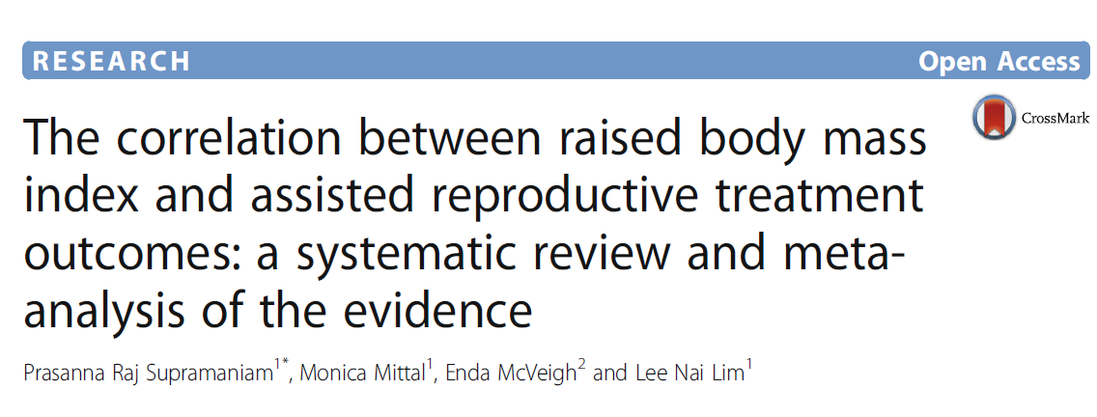
Obesità, Chirurgia Bariatrica e Procreazione Medicalmente Assistita
Impatto dell’obesità sulle procedure di Procreazione Medicalmente Assistita
2018
A total of 49 studies included in this systematic review.
Overweight and obese (BMI ≥ 25 kg/m²) women have a statistically significant lower live birth rate (OR 0.81, 95% CI 0.74–0.89, p < 0.00001) following Assisted Reproductive Technology (ART) when compared wn to women with a normal BMI.
An increase is also demonstrated in the number of miscarriages experienced by women with a BMI ≥ 30 kg/m²(OR 1.52, 95% CI 1.28–1.81, p < 0.00001).
Primary outcome : live birth rate following an IVF/ ICSI cycle. Secondary outcomes: clinical pregnancy rate; and, miscarriage rate.
Pooled analysis from 18 studies demonstrated a statistically significant reduction in the clinical pregnancy rate for women with a BMI ≥30 kg/m2 when compared to women with a normal BMI.
Increased total dosages of gonadotrophin was documented for women with a BMI ≥30 kg/m² when compared to women whose BMI fell into the normal category (13 studies pooled, WMD 363.58, 95% CI 252.99–474.17, p < 0.00001;).
Supramaniam PR, Mittal M, McVeigh E, Lim LN. The correlation between raised body mass index and assisted reproductive treatment outcomes: a systematic review and meta-analysis of the evidence. Reprod Health. 2018 Feb 27;15(1):34.

Slide 16
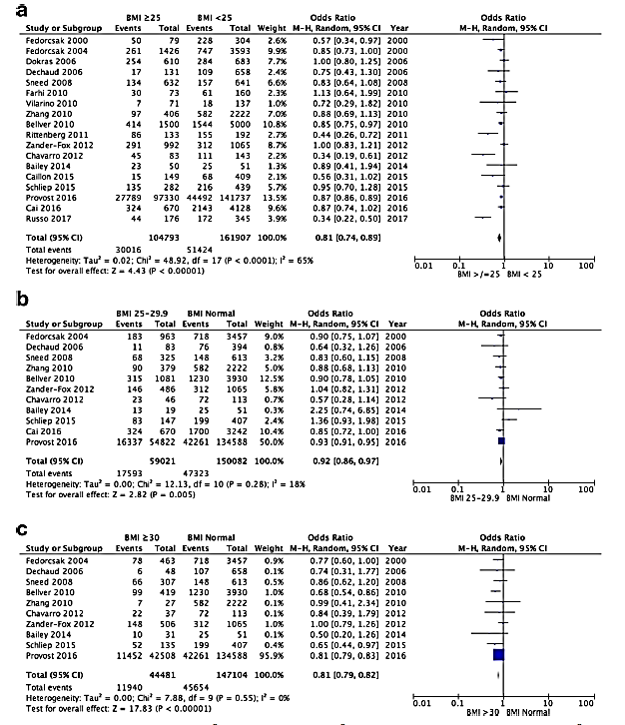
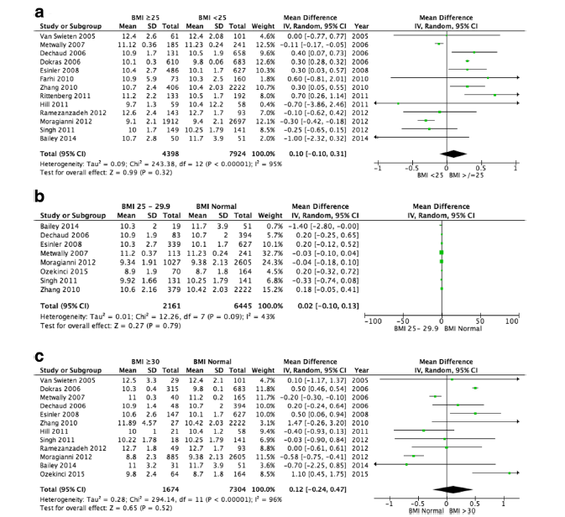
Obesità, Chirurgia Bariatrica e Procreazione Medicalmente Assistita
Impatto dell’obesità sulle procedure di Procreazione Medicalmente Assistita
2018
Meta-analysis of live-birth rate: (a) BMI ≥25 kg/m2 versus BMI < 25 kg/m²; (b) Normal BMI versus BMI 25–29.9 kg/ m²; (c) Normal BMI versus BMI ≥30 kg/ m²
Meta-analysis of duration of gonadotrophin stimulation: (a) BMI ≥25 kg/ m² versus BMI < 25 kg/ m²; (b) Normal BMI versus BMI 25–29.9 kg/m2; (c) Normal BMI versus BMI ≥30 kg/ m²
Supramaniam PR, Mittal M, McVeigh E, Lim LN. The correlation between raised body mass index and assisted reproductive treatment outcomes: a systematic review and meta-analysis of the evidence. Reprod Health. 2018 Feb 27;15(1):34.

Slide 17
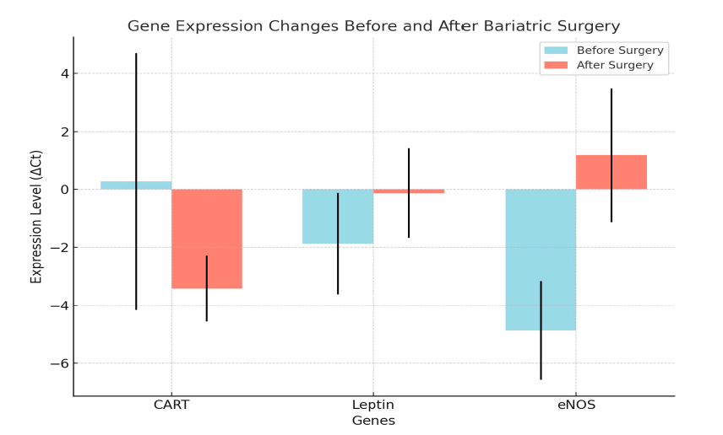
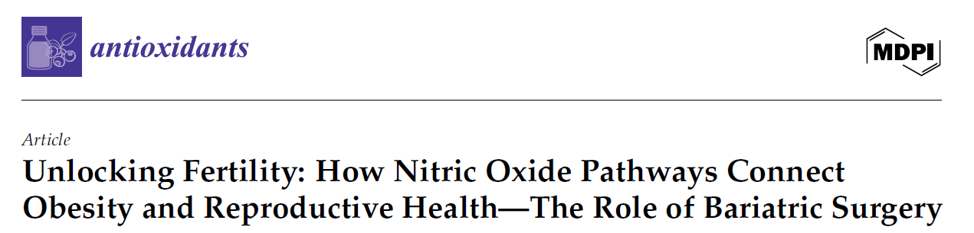
Obesità, Chirurgia Bariatrica e Procreazione Medicalmente Assistita
Impatto della Chirurgia Bariatrica e Metabolica sulle procedure di Procreazione Medicalmente Assistita (PMA)
2025
Relationship between obesity, oxidative stress, and reproductive dysfunction. Focus on the effects of sleeve gastrectomy on gene expression and hormonprofiles in 29 women with severe obesity (BMI ≥ 40 kg/m²).
Pre- and post-surgical investigations revealed significant differences in major gene expressions and hormonal markers. CART expression reduced significantly from 0.27 ± 4.43 to −3.42 ± 1.14 (p < 0.001), while leptin expression decreased from −1.87 ±1.75 to −0.13 ±1.55 (p < 0.001), indicating better metabolic regulation.
In contrast, eNOS expression increased considerably from −4.87 ± 1.70 to 1.18 ± 2.31 (p = 0.003), indicating improved endothelial function and nitric oxide bioavailability, which is critical for vascular health and reproduction.
Bariatric surgery significantly reduced CART and leptin expression (p < 0.001), indicating metabolic changes to weight loss, including improved energy balance and leptin sensitivity. These modifications underscore CART and leptin’s roles in hunger and energy regulation.
While no strong interdependence was found amongst the examined genes, these data indicate that eNOS, CART, and leptin may be useful biomarkers for metabolic and reproductive recovery after surgery.
Voros C, Mavrogianni D, Bananis K, Varthaliti A, Papahliou AM, Topalis V, Kondili P, Darlas M, Daskalaki MA, Pantou A, Athanasiou D, Mathiopoulos D, Theodora M, Antsaklis P, Loutradis D, Daskalakis G. Unlocking Fertility: How Nitric Oxide Pathways Connect Obesity and Reproductive Health-The Role of Bariatric Surgery. Antioxidants (Basel). 2025 Feb 19;14(2):240.

Slide 18
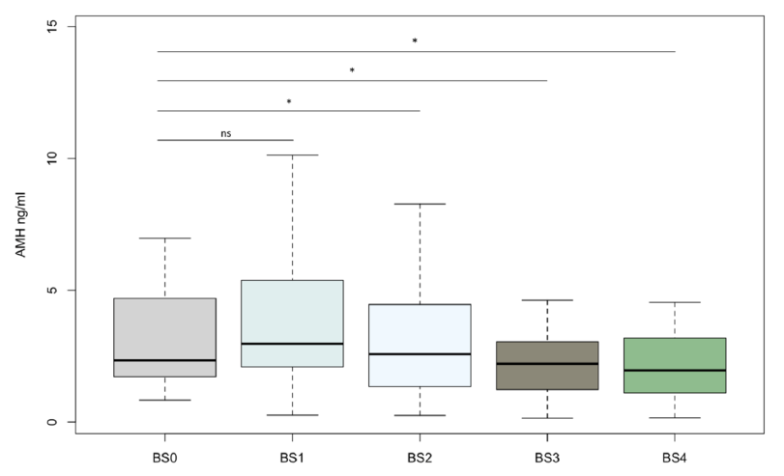
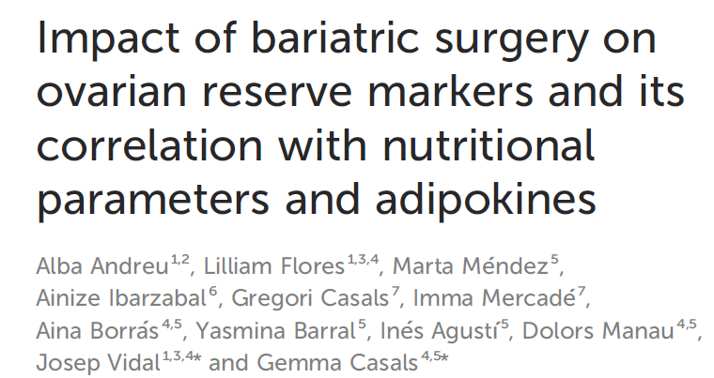
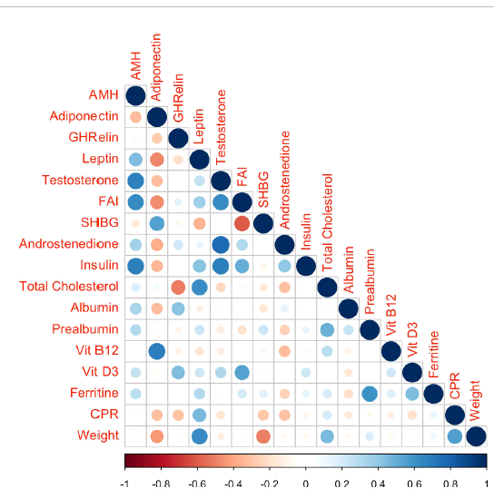
Obesità, Chirurgia Bariatrica e Procreazione Medicalmente Assistita
Impatto della Chirurgia Bariatrica e Metabolica sulle procedure di Procreazione Medicalmente Assistita (PMA)
2024
Certain hormones produced by the digestive system (i.e. ghrelin) and the adipose tissue (i.e. leptin, adiponectin) would maintain a dialogue with reproductive hormones at different levels of the hypothalamic-pituitary-ovarian axis through a complex network of interactions .
Among the reproductive hormones involved in this dialogue, anti-müllerian hormone (AMH) is crucial for ovarian folliculogenesis and has emerged as the most accurate hormonal marker of ovarian reserve, informing about the number of oocytes present within the ovaries of women at a specific moment of her life as well as the ovarian responsiveness to hormonal stimulation for in vitro fertilization (IVF) treatments
Significant decrease in AMH levels and a downward trend in AFC during the first 12 months after BS, followed by a subsequent stabilization of both ovarian reserve markers. AMH variations were associated with different reproductive and metabolic parameters, especially with androgen and insulin modifications
Andreu A, Flores L, Méndez M, Ibarzabal A, Casals G, Mercadé I, Borrás A, Barral Y, Agustí I, Manau D, Vidal J, Casals G. Impact of bariatric surgery on ovarian reserve markers and its correlation with nutritional parameters and adipokines. Front Endocrinol (Lausanne). 2024 Mar 15;15:1284576.

Slide 19
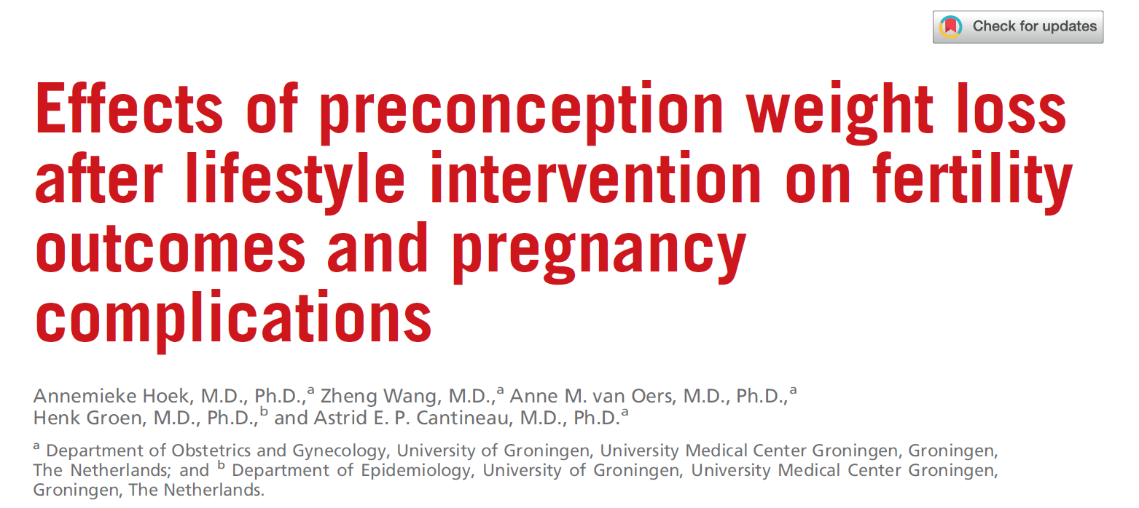
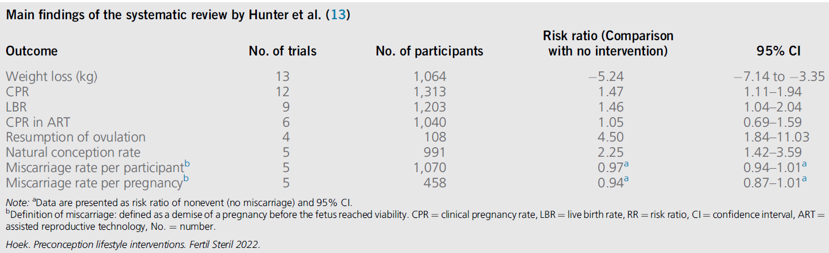
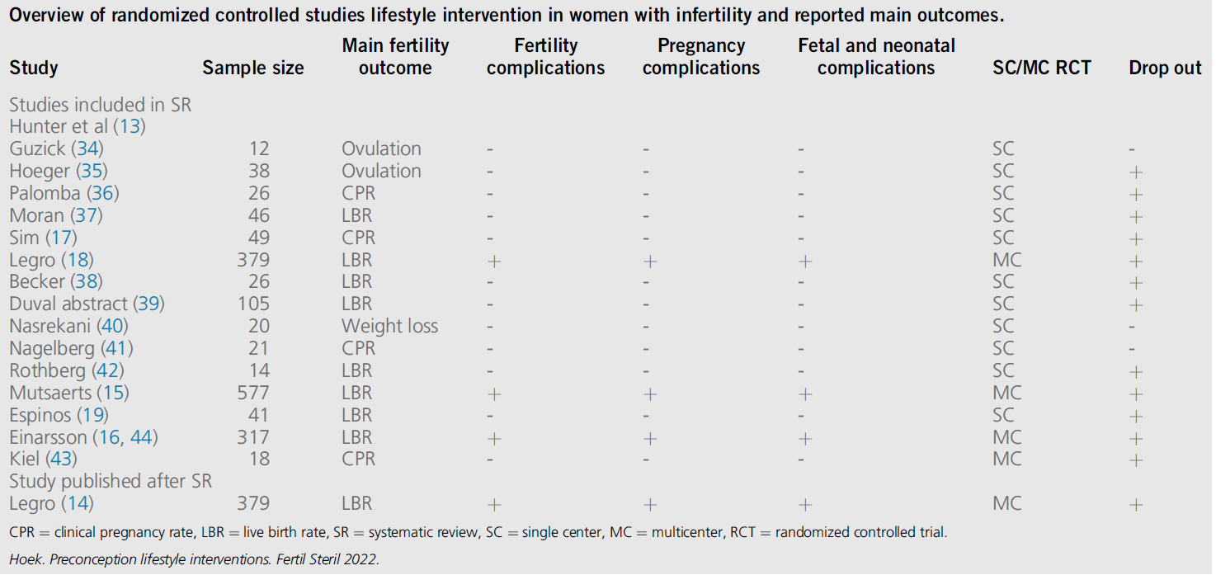
Obesità, Chirurgia Bariatrica e Procreazione Medicalmente Assistita
Impatto della Chirurgia Bariatrica e Metabolica sulle procedure di Procreazione Medicalmente Assistita (PMA)
2022
16 RCTs (15 full papers and 1 abstract) so far have been published on lifestyle interventions in women with overweight or obesity and infertility. There is a beneficial effect on weight loss, CPR, LBR, and natural conception rates after lifestyle intervention compared with control groups.
There seems no effect of lifestyle intervention before ART vs. immediate ART on CPR and LBR. There is no significant increased risk of early pregnancy loss in the latest SR, although the FIT-PLESE study showed a trend toward an increased risk. A limited number of 4 multicenter RCTs investigated maternal and fetal complication rates.
Current evidence suggests: more weight loss and an increase in CPR and LBR and more natural conceptions after lifestyle intervention were observed in women with overweight or obesity and infertility. With respect to potential harm of lifestyle intervention; in the current SR and meta-analysis there is no increased risk of miscarriage, although some doubt remains in the latest RCT not included in the SR.
Hoek A, Wang Z, van Oers AM, Groen H, Cantineau AEP. Effects of preconception weight loss after lifestyle intervention on fertility outcomes and pregnancy complications. Fertil Steril. 2022 Sep;118(3):456-462.

Slide 20
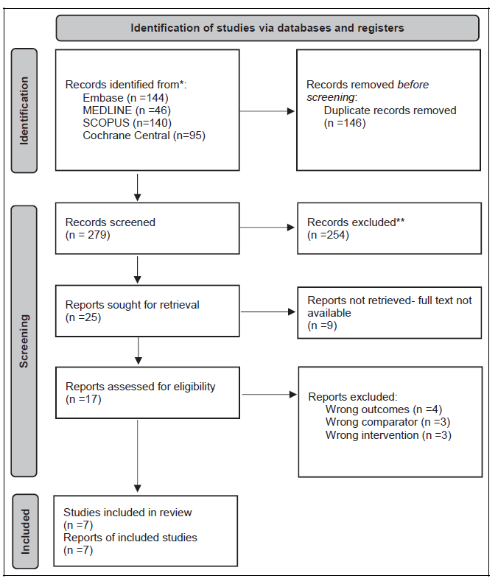
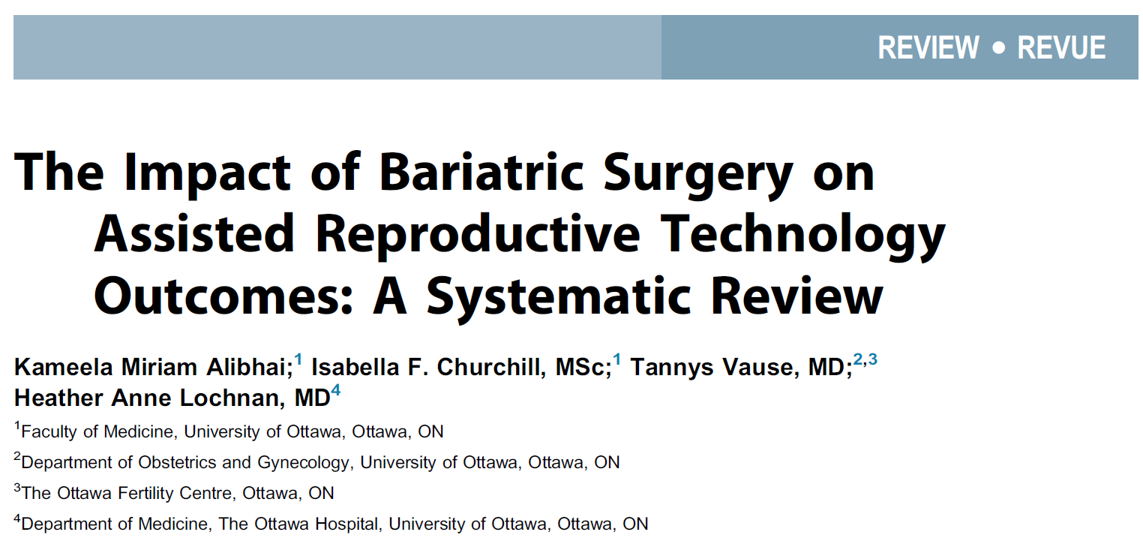
Obesità, Chirurgia Bariatrica e Procreazione Medicalmente Assistita
Impatto della Chirurgia Bariatrica e Metabolica sulle procedure di Procreazione Medicalmente Assistita (PMA)
2022
25 were sought for full text review, and 7 were included for analysis. Four studies (57%) examined ART interventions in females, while 3 (43%) examined interventions in males. Data on cumulative live birth rate (CLBR) was extracted for all 7 studies (N =169).
There were 50 live births with CLBRs ranging from 0.0% to 80.0%. Data on female secondary outcomes were varied. Data on male secondary outcomes were contradictory: 1 study indicated improved sperm parameters following bariatric surgery, while 2 showed decreased parameters, with certain participants seeing improvements after several months.
In terms of type of MBS, in 3 studies (43%) participants received either primarily restrictive (i.e., sleeve gastrectomy or adjustable gastric banding) or combination (i.e., Roux-en-Y gastric bypass) bariatric surgery; in 2 studies (28%) participants all received primarily restrictive bariatric surgery, specifically sleeve gastrectomy.
MBS prior to ART may have an impact on CLBR. Further secondary analyses showed that bariatric surgery prior to ART may also have sex-specific implications. Specifically, females, who are classified in lower BMI groups, may have a higher CLBR, whereas males may have worse sperm analysis indicators following surgery.
Alibhai KM, Churchill IF, Vause T, Lochnan HA. The Impact of Bariatric Surgery on Assisted Reproductive Technology Outcomes: A Systematic Review. J Obstet Gynaecol Can. 2022 Aug;44(8):915-923.

Slide 21
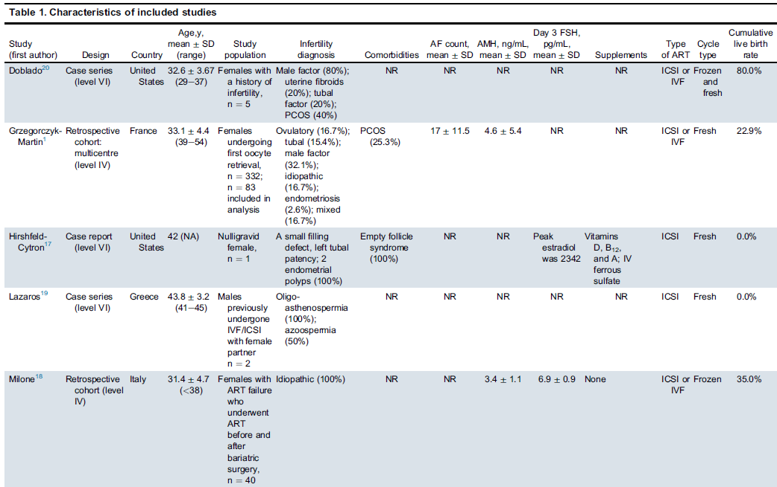
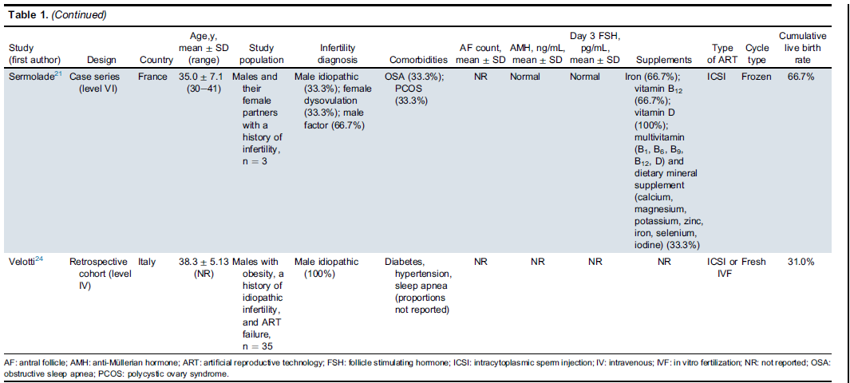
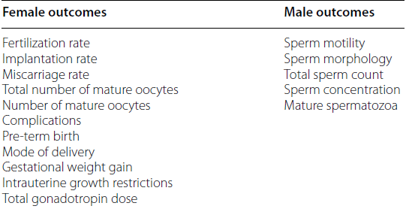
Obesità, Chirurgia Bariatrica e Procreazione Medicalmente Assistita
2022
Impatto della Chirurgia Bariatrica e Metabolica sulle procedure di Procreazione Medicalmente Assistita (PMA)
Alibhai KM, Churchill IF, Vause T, Lochnan HA. The Impact of Bariatric Surgery on Assisted Reproductive Technology Outcomes: A Systematic Review. J Obstet Gynaecol Can. 2022 Aug;44(8):915-923.

Slide 22
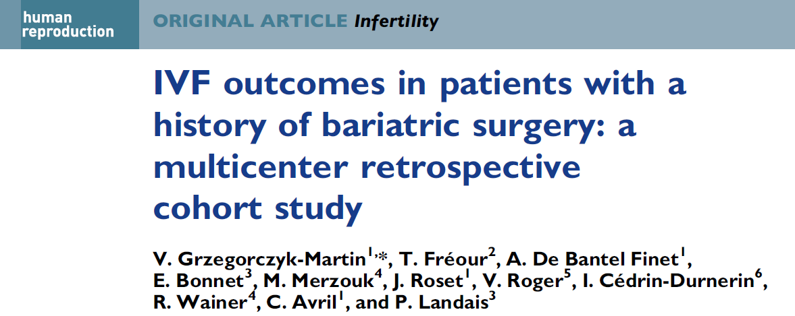
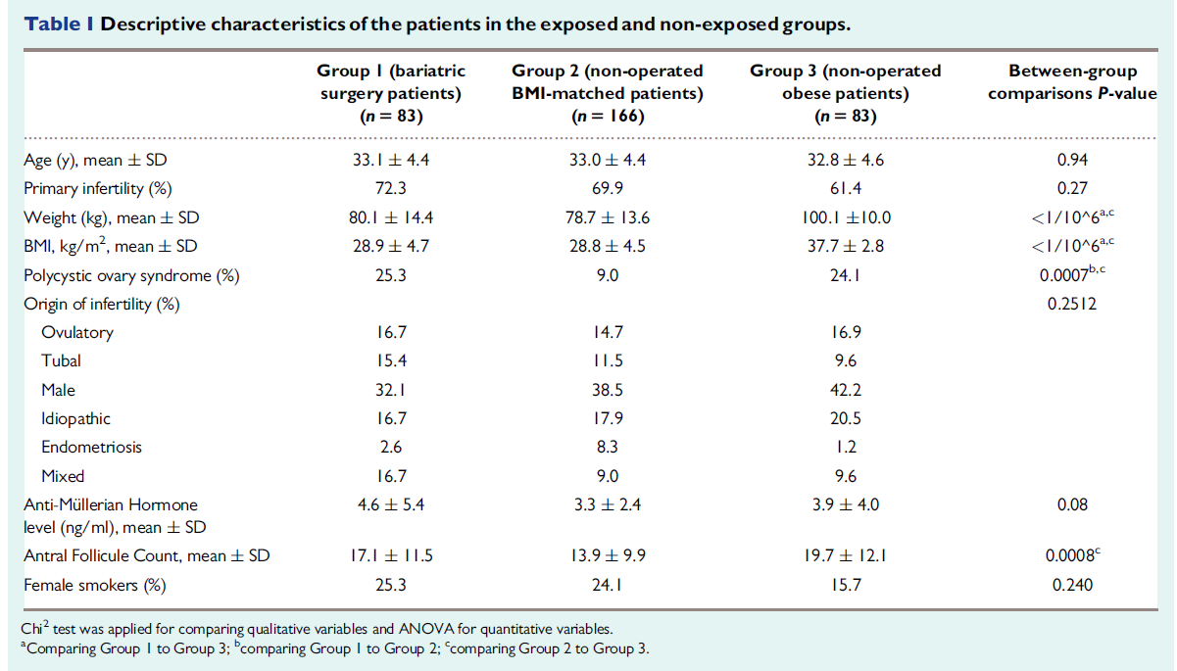
Obesità, Chirurgia Bariatrica e Procreazione Medicalmente Assistita
Impatto della Chirurgia Bariatrica e Metabolica sulle procedure di Procreazione Medicalmente Assistita (PMA)
2020
3 exposure groups of age-matched women undergoing their first IVF cycle were compared:
Group 1: 83 women with a history of bariatric surgery (exposure, mean BMI 28.9 kg/m²);
Group 2: 166 non-operated women (non-exposed to bariatric surgery, mean BMI=28.8 kg/m²) with a similar BMI to Group 1 at the time of IVF treatment;
Group 3: 83 non-operated severely obese women (non-exposed to bariatric surgery, mean BMI=37.7 kg/m²).
The main outcome measure was the comparable cumulative live birth rate (CLBR). Secondary outcomes were the number of mature oocytes retrieved and embryos obtained, implantation and miscarriage rates, live birth rate per transfer as well as birthweight.
IVF patients with a history of MBS had chances of live birth that were comparable to non-operated patients of the same BMI and age. Although the difference between non-operated severely obese and operated women did not achieve statistical significance, a trend toward lower CLBR in non-operated severely obese women was found, as demonstrated by a significant negative association between BMI and live birth rate. Additionally, severely obese patients showed a significantly lower live birth rate per transfer compared to the other two groups, suggesting a possible negative effect of obesity on implantation.
Grzegorczyk-Martin V, Fréour T, De Bantel Finet A, Bonnet E, Merzouk M, Roset J, Roger V, Cédrin-Durnerin I, Wainer R, Avril C, Landais P. IVF outcomes in patients with a history of bariatric surgery: a multicenter retrospective cohort study. Hum Reprod. 2020 Dec 1;35(12):2755-2762.

Slide 23


Obesità, Chirurgia Bariatrica e Procreazione Medicalmente Assistita
Impatto della Chirurgia Bariatrica e Metabolica sulle procedure di Procreazione Medicalmente Assistita (PMA)
2020
No significant difference in CLBR between the operated Group 1 patients and the two non-operated Groups 2 and 3 was observed (22.9%, 25.9%, and 12.0%, in Groups 1, 2 and 3, respectively).
No significant difference in average number of mature oocytes and embryos obtained was observed among the three groups.
The implantation rates were not different between Groups 1 and 2 and although lower (6.9%) in obese women of Group 3, this difference was not statistically significant.
Miscarriage rates in Groups 1, 2 and 3 were 38.7%, 35.8% and 56.5%, respectively (P0.256). Live birth rate per transfer in obese patients was significantly lower compared to the other two groups .
Multivariate analysis revealed that a 1-unit lower BMI increased the chances of live birth by 9%. In operated women, a significantly smaller weight for gestational age was observed in newborns of Group 1 compared to Group 3 (P 0.04).
Grzegorczyk-Martin V, Fréour T, De Bantel Finet A, Bonnet E, Merzouk M, Roset J, Roger V, Cédrin-Durnerin I, Wainer R, Avril C, Landais P. IVF outcomes in patients with a history of bariatric surgery: a multicenter retrospective cohort study. Hum Reprod. 2020 Dec 1;35(12):2755-2762.

Slide 24


Obesità, Chirurgia Bariatrica e Procreazione Medicalmente Assistita
Impatto della Chirurgia Bariatrica e Metabolica sulle procedure di Procreazione Medicalmente Assistita (PMA)
2023
This study aims to estimate the time to pregnancy and live birth and evaluate the effect of recurrent weight regain in women with a history of MBS who underwent in vitro fertilization (IVF) treatments. All patients with previous BS who underwent IVF treatment in a tertiary university-affiliated hospital between 2013 and 2022 were included.
Women who maintained their nadir BMI following MBS had nearly twice the chance of achieving a clinical pregnancy (HR 1.967, 95% CI: 1.026–3.771, p = 0.042) and were approximately three times more likely to achieve a live birth (2.864, 95% CI: 1.196–6.859, p = 0.018) than those who regained at least three points of BMI.
Recurrent weight gain after BS is associated with a lower rate of live births and prolonged time to achieve clinical pregnancy and live birth.
Zemer-Tov B, Ziv-Baran T, Igawa M, Lieberman G, Orvieto R, Machtinger R. Weight Regain following Bariatric Surgery and in vitro Fertilization Outcomes. Obes Facts. 2024;17(6):593-601.

Slide 25


Obesità, Chirurgia Bariatrica e Procreazione Medicalmente Assistita
Impatto della Chirurgia Bariatrica e Metabolica sulle procedure di Procreazione Medicalmente Assistita (PMA)
2023
The high prevalence of weight regain after BS, along with our essential finding that a relatively small regain is sufficient to negatively affect the rates of both clinical pregnancies and live births, is disturbing and merits medical attention.
This study suggests rates and a detailed timeframe for pregnancy and live births among patients undergoing IVF after BS for both physicians and patients.
Cumulative pregnancy rates of positive β-hCG (a), clinical pregnancy (b), and live birth (c) in women who gained less than 3 kg/m2 and in women who gained more.
Zemer-Tov B, Ziv-Baran T, Igawa M, Lieberman G, Orvieto R, Machtinger R. Weight Regain following Bariatric Surgery and in vitro Fertilization Outcomes. Obes Facts. 2024;17(6):593-601.

Slide 26



Obesità, Chirurgia Bariatrica e Procreazione Medicalmente Assistita
Impatto della Chirurgia Bariatrica e Metabolica sulle procedure di Procreazione Medicalmente Assistita (PMA)
2022
Swedish women between 18 and 45 years operated with BS, with at least one first started cycle of IVF after surgery, were included.
For each woman having IVF after BS (n=153), up to five non-operated control women (n=744) starting their first IVF cycle during the study period were matched for age, parity and BMI at treatment.
The primary outcome was the cumulative live birth rate (CLBR) after the first IVF cycle, defined as all live births after the first cycle including fresh and frozen embryo transfers.
Nilsson-Condori E, Mattsson K, Thurin-Kjellberg A, Hedenbro JL, Friberg B. Outcomes of in-vitro fertilization after bariatric surgery: a national register-based case-control study. Hum Reprod. 2022 Sep 30;37(10):2474-2481.

Slide 27


Obesità, Chirurgia Bariatrica e Procreazione Medicalmente Assistita
Impatto della Chirurgia Bariatrica e Metabolica sulle procedure di Procreazione Medicalmente Assistita (PMA)
2022
In this national register-based case–control study, no negative effect of previous BS on IVF outcomes were found.
CLBRs in surgery-treated patients were on par (29.4%) with the rates among matched controls (33.1%), even though the number of retrieved oocytes, 7.6 vs 8.9, and frozen embryos, 1.0 vs 1.5, were significantly lower.
The perinatal outcomes were also generally comparable. There was no increase in the prevalence of preterm birth or SGA; however, the mean birth weight was significantly lower in the children of BS patients.
Nilsson-Condori E, Mattsson K, Thurin-Kjellberg A, Hedenbro JL, Friberg B. Outcomes of in-vitro fertilization after bariatric surgery: a national register-based case-control study. Hum Reprod. 2022 Sep 30;37(10):2474-2481.

Slide 28


Obesità, Chirurgia Bariatrica e Procreazione Medicalmente Assistita
Impatto della Chirurgia Bariatrica e Metabolica sulle procedure di Procreazione Medicalmente Assistita (PMA)
2021
35 men with obesity and idiopathic infertility included in this study.
A significant increase, after MBS , in semen volume, total sperm concentration, progressively motile sperm count, and sperm morphology were reported. Considering IVF outcomes, mean number of top-quality oocytes, mean number of fertilized oocytes, mean number of embryos obtained, and top-quality embryos were significantly increased after MBS.
Bariatric surgery(i.e. LSG in the study) is confirmed to be safe and effective in increasing the outcomes of assisted reproductive technology treatment also in case of infertile men with obesity, both in terms of pregnancy and live birth rate.
Velotti N, Elisa De Palma FD, Sosa Fernandez LM, Manigrasso M, Galloro G, Vitiello A, Berardi G, Milone M, De Palma GD, Musella M. Effect of bariatric surgery on in vitro fertilization in infertile men with obesity. Surg Obes Relat Dis. 2021 Oct;17(10):1752-1759.

Slide 29


Obesità, Chirurgia Bariatrica e Procreazione Medicalmente Assistita
Impatto della Chirurgia Bariatrica e Metabolica sulle procedure di Procreazione Medicalmente Assistita (PMA)
2021
The rationale to explain the benefit of MBS on ART outcomes relies in the weight loss obtained after MBS: the seminal vesicles and prostate are under androgen control and the reduction of seminal IL-8 levels, considered one of the body levels responsible for reduced seminal volume, and associated with high BMI.
This findings are probably secondary to the metabolic changes induced by MBS over, insulin resistance can reduce sex hormone-binding globulin (SHBG) levels, increasing the percentage of free estradiol (E2) and inducing a negative feedback on FSH, LH and testosterone levels .
LSG induces downregulation of the inflammatory adipocytokines TNF-a and IL-6 and increases the expression and distribution of glucose transporter 4 (GLUT4) in adipose tissue, inducing an improvement in glucose tolerance and insulin resistance.
Velotti N, Elisa De Palma FD, Sosa Fernandez LM, Manigrasso M, Galloro G, Vitiello A, Berardi G, Milone M, De Palma GD, Musella M. Effect of bariatric surgery on in vitro fertilization in infertile men with obesity. Surg Obes Relat Dis. 2021 Oct;17(10):1752-1759.

Slide 30


TAKE HOME MESSAGES
Clinicians involved in obesity management should be aware of the possible and preventable consequences of higher BMI in both female and male infertile subjects counselling for IVF.
Recurrent weight gain have negative consequence on IVF outcome. Therefore, weight maintenance and relatively early IVF treatment after BS should be recommended to improve pregnancy outcomes.
Importance of multidisciplinary care of infertile couples, and advocate for further discussion on whether MBS should be proposed in severely obese infertile women before IVF.
A holistic approach should be used when counselling patients seeking ART treatments using an open discussion method to inform patients of the effects of raised BMI on ART and obstetric care. This will allow couples to make an informed decision and to take ownership of their well-being.

Slide 31

Grazie

